Slide 1
YOUTUBE GROWTH &
REVENUE ANALYSIS

Slide 2

CONTENTS
I. BUSINESS PROBLEM
II. ANALYSIS AND FINDINGS
CATEGORY LEVEL FINDINGS
CHANNEL TYPE ANALYSIS
SUBSCRIBER TRENDS & CONTENT ACTIVITY
EARNINGS INSIGHTS: TOP PERFORMERS & REVENUE CORRELATIONS
III. INSIGHTS AND RECOMMENDATIONS

Slide 3
I. BUSINESS PROBLEM

Slide 4

BUSINESS PROBLEM
This project presents an in-depth exploratory data analysis (EDA) of a comprehensive YouTube dataset, focusing on uncovering trends in content categories, channel types, countries, and creator performance.
The primary objective is to identify actionable insights that could guide aspiring content creators, marketers, or media strategists in understanding where growth and monetization opportunities lie on the platform.

Slide 5
II. ANALYSIS & FINDINGS

Slide 6
1. CATEGORY LEVEL FINDINGS

Slide 7
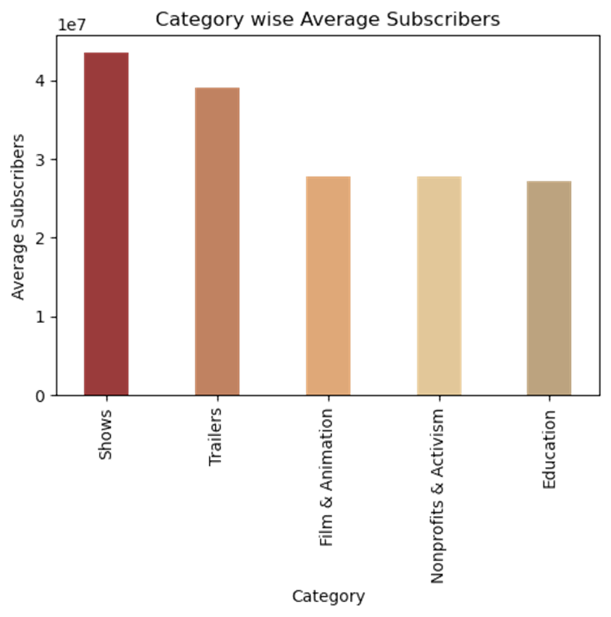
CATEGORY WISE AVERAGE SUBSCRIBERS
The bar chart represents the average number of subscribers across different YouTube categories.
The "Shows" category has the highest average number of subscribers, exceeding 40 million, making it the most popular category.
The "Trailers" category also boasts a significant average subscriber count, likely reflecting the broad interest in movie and TV trailers.
"Film and Animation" maintains a solid average of over 30 million subscribers, highlighting the appeal of creative and visual content.
"Nonprofits and Activism" follows with a respectable average of around 30 million subscribers, despite its focus on social causes and activism.
The "Education" category closely follows, suggesting that educational content maintains strong demand among audiences.

Slide 8
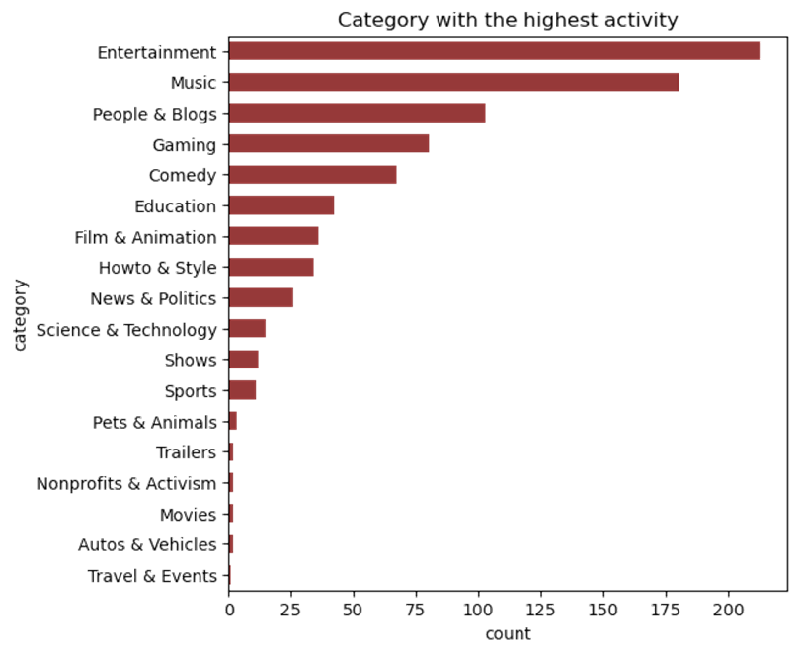
CATEGORY WITH HIGHEST ACTIVITY
The bar chart represents the categories with the highest activity, likely represented by the count of occurrences for each category.
Top categories: “Entertainment” has the highest activity, with around 200 occurrences. This indicates that Entertainment is the most active category in this dataset. “Music” follows as the second most active category, with a count slightly lower than Entertainment
Moderate Activity Categories: “People & Blogs” and “Gaming” are also popular categories, with substantial counts compared to others. “Comedy” has a notable count but is less active compared to the top categories.
Lower Activity Categories: “Education”, “Film & Animation”, and “How to & Style” fall into the mid-range in terms of activity. “News & Politics” and “Science & Technology” have lower activity compared to the more general and entertainment-oriented categories.
Least Active Categories: Categories like “Shows”, “Sports”, “Pets & Animals”, “Trailers”, “Nonprofits & Activism”, “Movies”, “Autos & Vehicles”, and “Travel & Events” have the least activity, with very low counts.

Slide 9
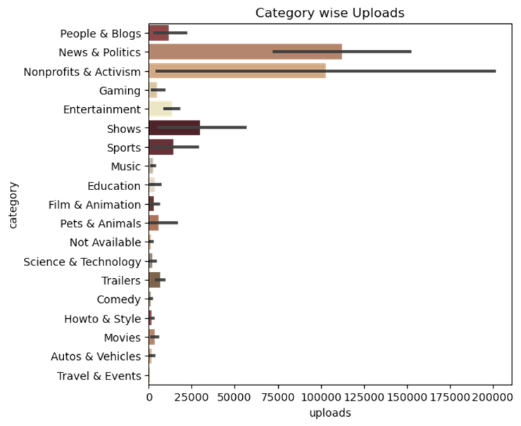
CATEGORY WISE UPLOADS
This visual is a horizontal bar chart that displays the number of uploads across different content categories.
Top categories: The “Nonprofits & Activism” category leads in the number of uploads, nearing 200,000, indicating a strong focus on content centered around social causes and activism. The “News & Politics” category follows closely, reflecting a substantial volume of content related to current events, news, and political commentary. Meanwhile, the “People & Blogs” category exhibits a moderate level of uploads, suggesting that personal vlogs and blogs are also popular, though not to the same extent as the aforementioned categories
Moderate categories: The “Shows” category has a considerable number of uploads, followed by the “Sports” category which shows a moderate volume of uploads, indicating a consistent flow of content related to sports activities, events, and discussions.
Low upload categories: Categories like “Movies”, “Autos & Vehicles”, “Travel & Events”, and “Trailers” have very low numbers of uploads. Categories like “Education”, “Science & Technology”, and “Music” have relatively low uploads compared to the top categories. This could suggest either a lower interest or fewer creators in these areas.

Slide 10
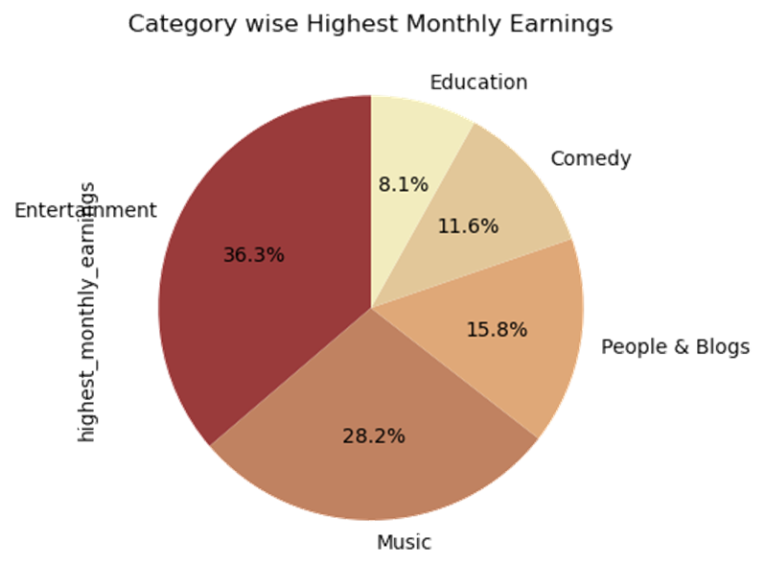
CATEGORY WISE HIGHEST MONTHLY EARNINGS
The pie chart is displaying the distribution of highest monthly earnings by category.
“Entertainment” has the highest share of earnings at 36.3%. “Music” follows with 28.2%. “People & Blogs” constitutes 15.8% of the earnings. “Comedy” accounts for 11.6%. “Education” has the smallest share at 8.1%.
Dominant Categories: “Entertainment” and “Music” are the top-earning categories. The Entertainment category significantly outperforms other categories in terms of earnings, indicating the strong monetization potential in this segment. Music also holds a substantial share, reflecting its global appeal and high engagement rates
Smaller Categories: Categories like “People & Blogs” and “Comedy”, while popular, generate relatively lower earnings compared to Entertainment and Music. “Education” has the smallest share, suggesting either fewer monetization opportunities or a smaller audience base in comparison to other categories

Slide 11
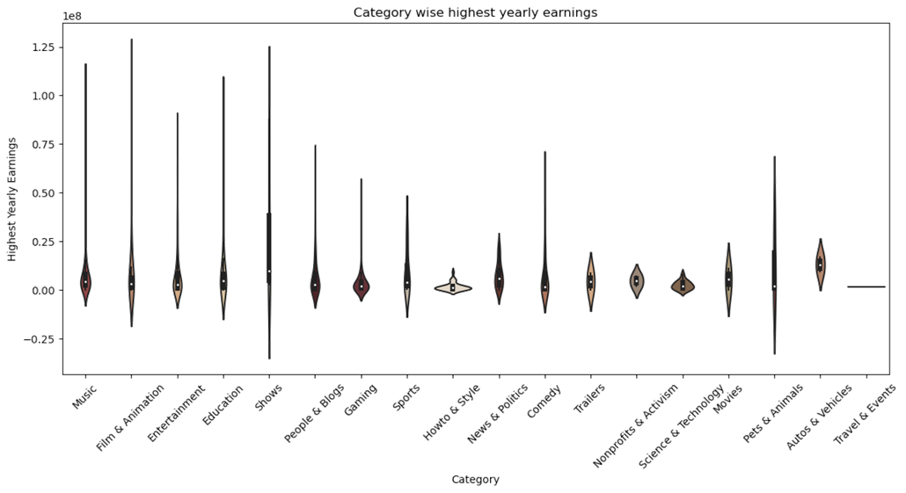
CATEGORY WISE HIGHEST YEARLY EARNINGS
The violin plot represents the category wise highest yearly earnings
Categories such as “Music”, “Film & Animation”, and “Entertainment” show a broad distribution with several high-earning outliers. The “Shows” category has the widest spread, indicating a highly variable range of earnings.
Categories like “How to & Style” and “Nonprofits & Activism” have a more concentrated distribution, suggesting consistent earnings among these channels. “Gaming” and “Education” categories also show a fairly concentrated earnings range with fewer outliers.
Outliers: Several categories, such as “Music”, “Film & Animation”, and “Shows”, have significant outliers. The “Pets & Animals” and “Autos & Vehicles” categories also show some variability but with fewer extreme outliers.

Slide 12
2. CHANNEL TYPE ANALYSIS

Slide 13
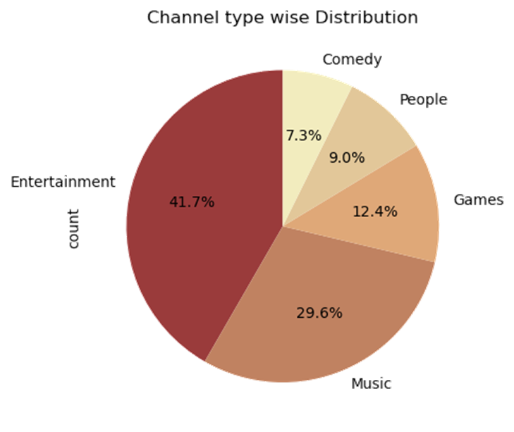
CHANNEL TYPE DISTRIBUTION
The pie chart shows the distribution of different channel types.
Dominant Channel Type: “Entertainment” channels have the largest share, making up 41.7% of the total distribution. This suggests that entertainment is the most popular channel type in this dataset.
Significant Channel Types: “Music” channels are the second most common type, constituting 29.6% of the total. “Games” channels account for 12.4% of the distribution.
Smaller Categories: “People” channels make up 9.0% of the distribution. “Comedy” channels have the smallest share at 7.3%

Slide 14
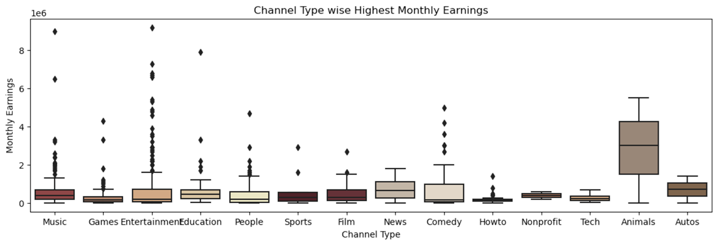
CHANNEL TYPE HIGHEST MONTHLY EARNINGS
The box plot shows the distribution of monthly earnings for various channel types on YouTube
Channel type highest monthly earnings: “Tech channels” have the highest median monthly earnings, followed by “Animals” and “Entertainment channels”.
Channel type with lower monthly earnings: The median earnings of channels like “Sports”, “How-to”, and “Nonprofit” are relatively lower compared to other categories. The length of the boxes indicates the interquartile range (IQR), showing the spread of earnings within each category. The “Animals” and “Entertainment” categories have a wider IQR, indicating a greater variation in monthly earnings among channels in these categories. Categories like “Games” and “How-to” have a narrower IQR, suggesting less variation in their monthly earnings..

Slide 15
3. SUBSCRIBER TRENDS & CONTENT ACTIVITY

Slide 16
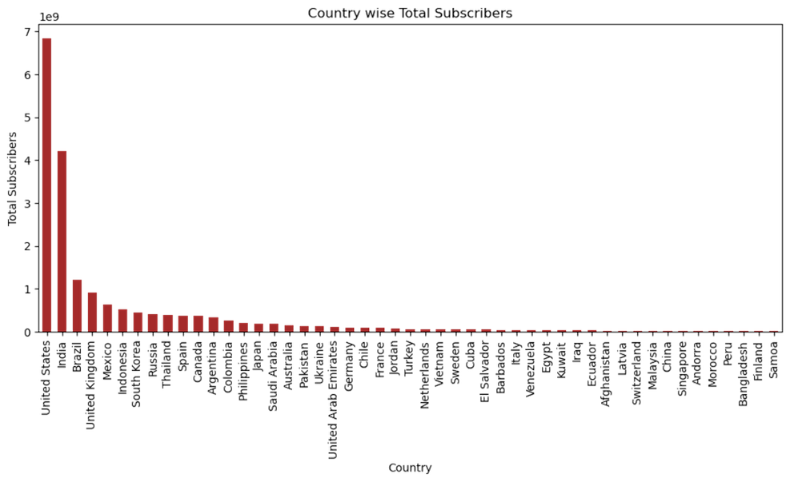
COUNTRY WISE SUBSCRIBERS
The bar chart represents the total subscribers for each country
Dominant Country: The United States has the highest number of total subscribers, significantly more than any other country. Its bar is much taller than the others, indicating a very large subscriber base.
Top Countries: After the United States, the countries with the highest subscriber counts are India, Brazil, and the United Kingdom. These countries have a noticeable drop in subscriber numbers compared to the United States but still stand out among the rest.
Other Countries: The remaining countries have relatively small numbers of subscribers, as indicated by the short bars. These include a wide range of countries from different regions, such as Indonesia, Mexico, and South Korea, among others.

Slide 17
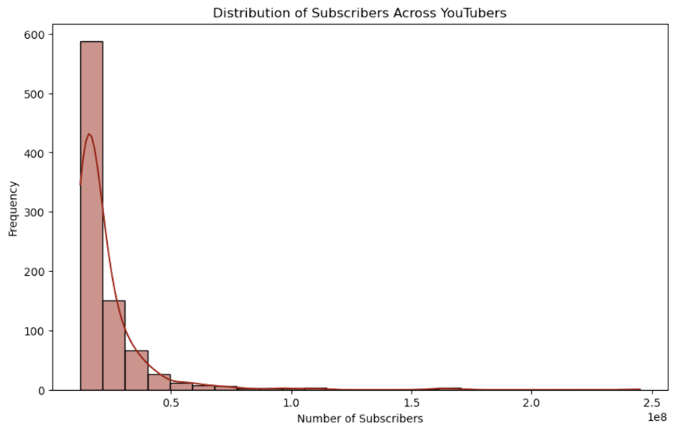
DISTRIBUTION OF SUBSCRIBERS
The histplot represents the distribution of subscribers across YouTubers
The plot shows a clear right-skew, meaning that the majority of YouTubers have relatively low subscriber counts, while a few channels have very high subscriber numbers
Most of the data is concentrated in the first few bins (toward the left side of the chart), indicating that a large number of YouTubers have subscribers in the lower range

Slide 18
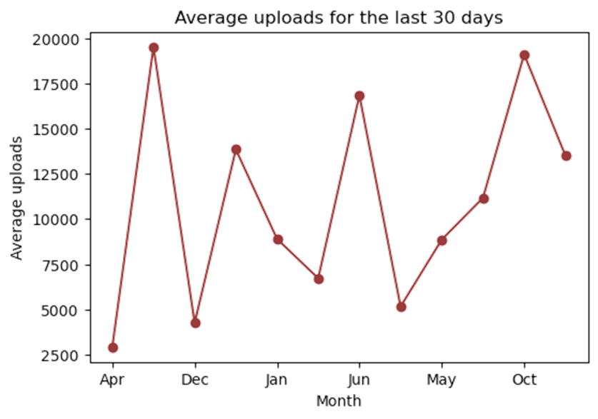
AVERAGE UPLOADS
The bar chart represents the total subscribers for each country
Dominant Country: The United States has the highest number of total subscribers, significantly more than any other country. Its bar is much taller than the others, indicating a very large subscriber base.
Top Countries: After the United States, the countries with the highest subscriber counts are India, Brazil, and the United Kingdom. These countries have a noticeable drop in subscriber numbers compared to the United States but still stand out among the rest.
Other Countries: The remaining countries have relatively small numbers of subscribers, as indicated by the short bars. These include a wide range of countries from different regions, such as Indonesia, Mexico, and South Korea, among others.

Slide 19
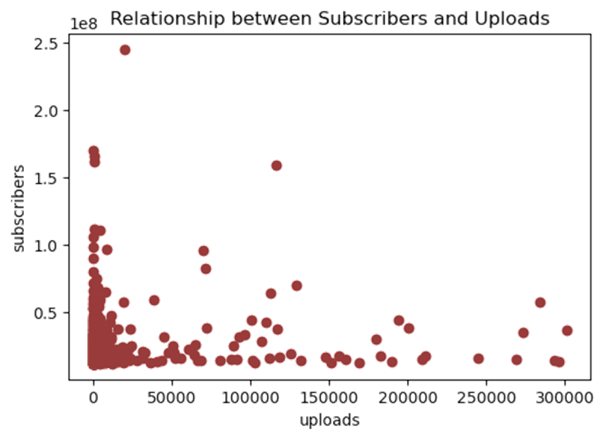
RELATION BETWEEN SUBSCRIBERS & UPLOADS
The scatter plot shows the relationship between subscribers and uploads
The scatter plot shows a large concentration of data points towards the lower left corner, indicating that many channels have fewer uploads and subscribers.
The number of channels significantly decreases as the number of uploads increases beyond 50,000
Outliers: There are a few outliers visible on the plot, where channels have an exceptionally high number of subscribers (over 200 million) despite having a relatively low number of uploads (around 50,000). Another set of outliers includes channels with high uploads (above 100,000) but moderate subscriber counts.

Slide 20
4. EARNINGS INSIGHTS: TOP PERFORMERS & REVENUE CORRELATIONS

Slide 21
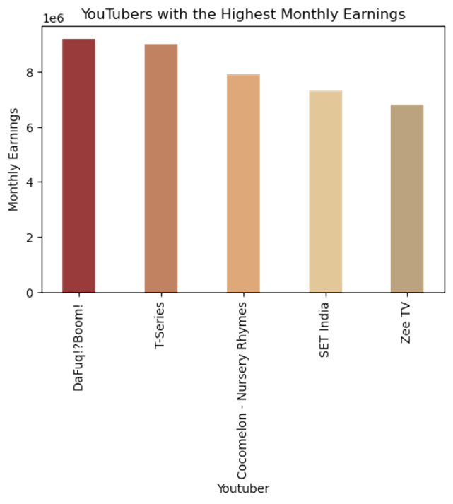
YOUTUBERS WITH HIGHEST MONTHLY EARNINGS
This visual is a bar chart representing the monthly earnings of the top five YouTubers with the highest earnings
Top earning YouTubers: “Dafuq!?Boom!” has the highest monthly earnings, slightly above 9 million. This indicates a strong performance, likely due to high views, ad revenue, or sponsorship deals.
Other high earning YouTubers: “T-Series” follows closely with monthly earnings slightly below Dafuq!?Boom!, showcasing its popularity and extensive reach, especially in the Indian market. “Cocomelon - Nursery Rhymes” ranks third, reflecting the high demand for children’s content on YouTube. “SET India” and “Zee TV” also feature in the top five, highlighting the dominance of Indian entertainment channels on the platform.

Slide 22
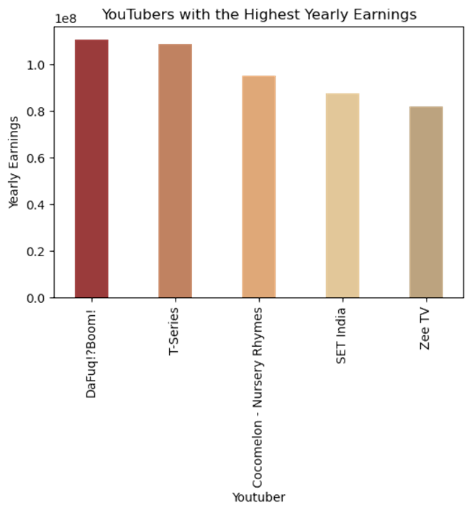
YOUTUBERS WITH HIGHEST YEARLY EARNINGS
The above line chart represents the YouTubers with highest yearly earnings.
Highest Earner: “DaFuq!?Boom!” appears to have the highest yearly earnings, exceeding 1.0 x 10^8 (100 million) in the represented currency
Top Contenders: “T-Series” closely follows, with earnings nearly equal to DaFuq!?Boom!. “Cocomelon - Nursery Rhymes” is the third highest, with earnings slightly below T-Series
Other Significant Channels: “SET India” and “Zee TV” are fourth and fifth, respectively. Their earnings are lower than the top three but still substantial.

Slide 23
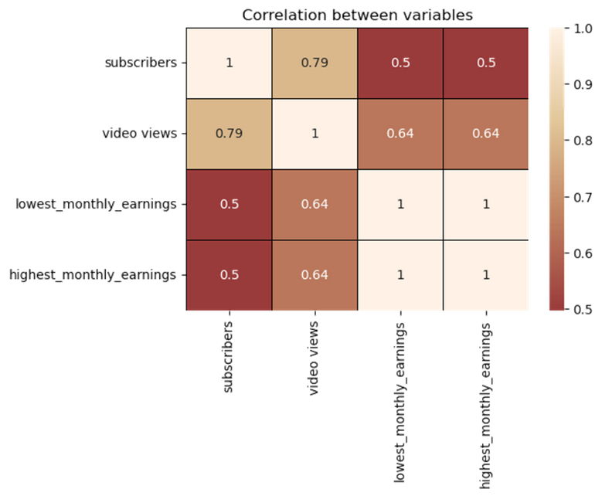
CORRELATION B/W SUBSCRIBERS, VIEWS & EARNINGS
This visual is a correlation matrix, which shows the relationships between different variables using correlation coefficients.
Subscribers & Video Views: Correlation of 0.79. This is a strong positive correlation, indicating that as the number of subscribers increases, the number of video views also tends to increase.
Video Views & Monthly Earnings (both lowest and highest): Correlation of 0.64. This suggests a moderate positive relationship, meaning that higher video views are associated with higher monthly earnings.
Subscribers & Monthly Earnings (both lowest and highest): Correlation of 0.5. This indicates a moderate positive relationship, suggesting that an increase in subscribers is moderately associated with an increase in monthly earnings.
Lowest & Highest Monthly Earnings: Correlation of 1

Slide 24
III. INSIGHTS & RECOMMENDATIONS

Slide 25
INSIGHTS & RECOMMENDATIONS
“Gaming”, “Music”, and “Entertainment” emerged as the most active and highly subscribed categories, but also show high competition.
Certain categories like “Education” or “How-to & Style” show promising subscriber counts with relatively fewer channels — indicating lower saturation.
Channel types such as “Entertainment” and “Gaming” have the highest monthly earnings, while How-to and News channels often have steady but lower revenue.
Channels in “Entertainment”, “Music”, “Tech”, and “Animals” can boost earnings by maintaining consistent content and forming brand partnerships
YouTubers can expand their reach by targeting countries beyond the US, India, and the UK, where digital literacy and infrastructure are improving
Creators can expand globally by producing multilingual content or localizing videos for regions with growing digital access, particularly outside top markets like the US, India, and the UK
Creators can optimize content strategies by leveraging performance data, such as top-performing video types and viewer demographics, to boost engagement and audience retention.

Slide 26
THANK YOU

